Slide 1
A Way to Health with Nutrition
Mav Khun, PhD student in Nutrition
Institute of Nutrition, Mahidol University, Thailand
Institute of Nutrition Sciences, International Nutrition, Justus Liebig University, Germany.

Slide 2
What is Nutrition?
Macronutrients
Carbohydrate
Lipids
Proteins
Micronutrients
Vitamins
Water soluble vitamins
Fat soluble vitamins
Minerals
Macrominerals: Ca, P, Mg, Na, K, Cl, S,
Microminerals: Fe, Zn, Cu, Se, I, Mn, Mo, F,

Slide 3
How to Optimum Your Health?
Diet
Exercise
Smoking
Alcohol and
Stress

Slide 4
Diet? Protect us from two biggest killers; heart disease and cancer
Vegetarians live seven years longer.
Vegetarians have 30% less heart disease than meat eaters.

Slide 5
High body weight vs healthy BMI
Healthy diet: leafy greens, tomatoes, red pepper, peas, rice, nuts, fresh fruits, and a little red wine.
Choosing fresh foods rather than left over foods.

Slide 6
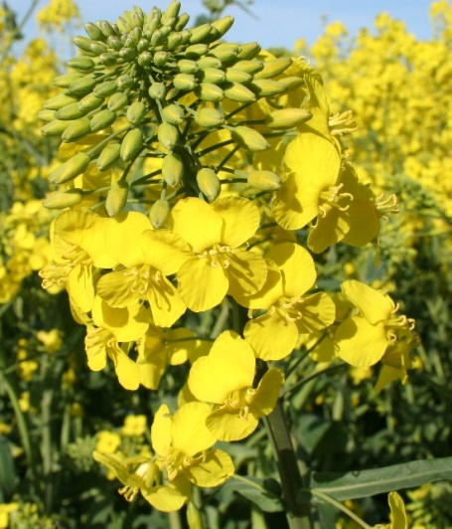
FAT
Olive oil, canola oil, avocado and
Fish oil, peanut oil, sunflower oil, sesame oil, safflower oil are USFA
Meat and butter are SFA
SFA
Increases risk of cancer, DM and HD

Slide 7
Exercise
Half an hour, four t five days per week
Walking
Take the steps rather than escalators

Slide 8
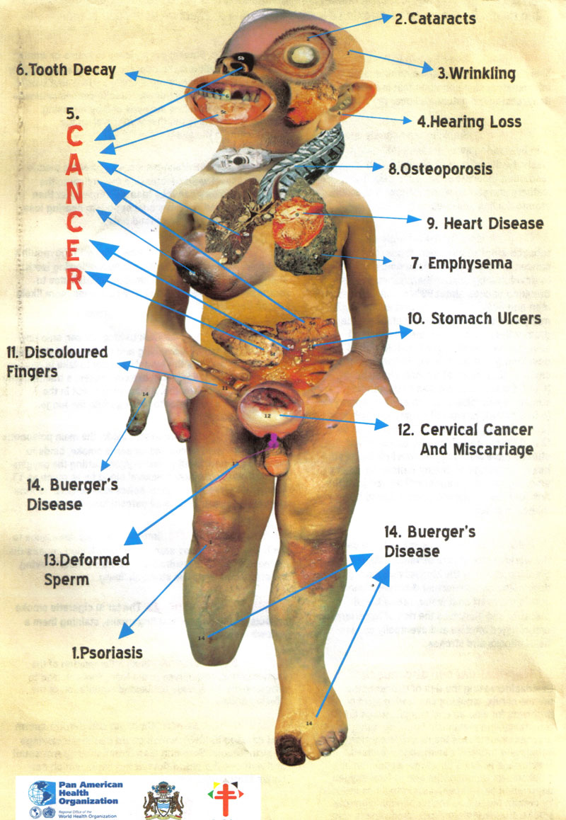
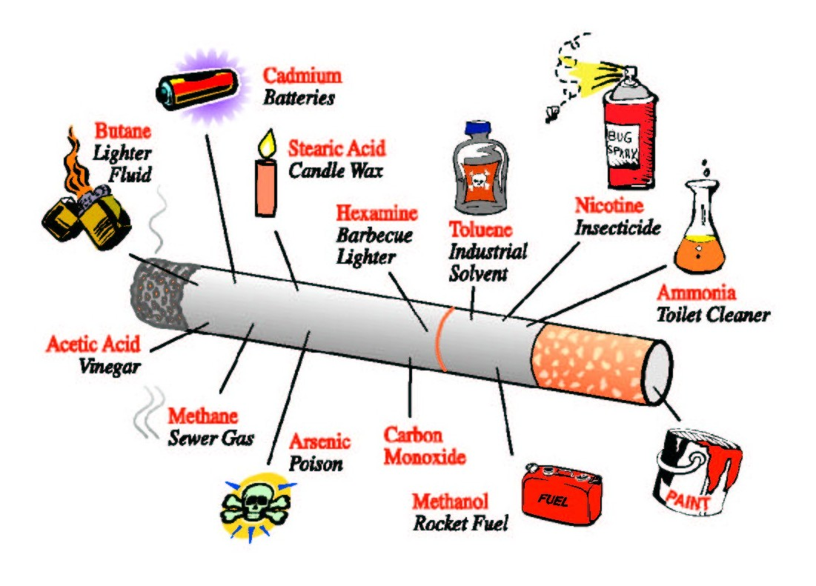
Smoking?

Slide 9
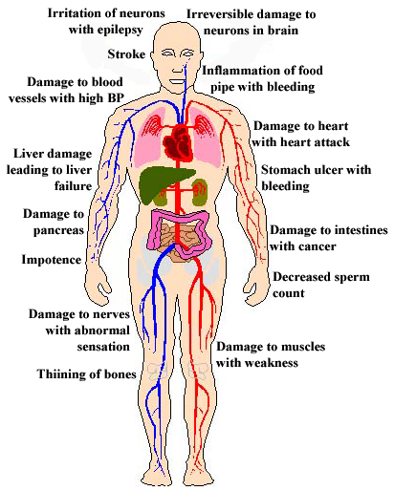
Alcohol?

Slide 10
Stress and Solution
Social environment
Family environment
STRESS
Air pollution
Physical injuries
Saturated fats
Excessive exercise

Slide 11
Solution to Stress
Daily meditation
Sitting quietly and enjoying a view
Yoga practice
50-60%
Reduction
in HD and cancer

Slide 12
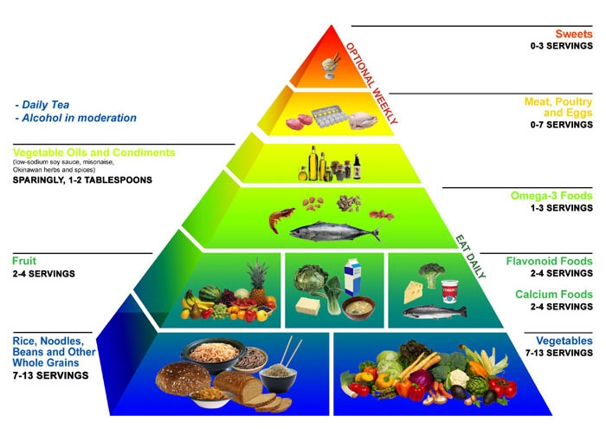
Solution to Stress

Slide 13
Risk Factors to Health
Major risk factors
High cholesterol
Cigarette smoking-
Hypertension (HBP)
Diabetes
Family history of vascular disease before 55
Minor risk factors
Obesity
Sedentary
Stress
Infections
Gout

Slide 14
Antioxidants and Free Radicals
FR - unstable chemicals (electrons) generated when the body is exposed to stress, damaging cells, proteins, DNA and collagen.
FR in the body are produced by tobacco, pollutants, and agricultural spray.
Smoking a cigarette → three trillion FR in our blood stream.

Slide 15
Antioxidants and Free Radicals
Antioxidants – olive oil, tea, fruits, vegetables, red wine and some vitamins and minerals.
Tea - > 30% of antioxidant intake in the diet of Australians comes from tea.
Red wine – 10-50% decreases CVD with 2-3 standard drink per day. ( 1 Sd drink of wine=100 mls; the best is 200 mls per day).

Slide 16
